Slide 1
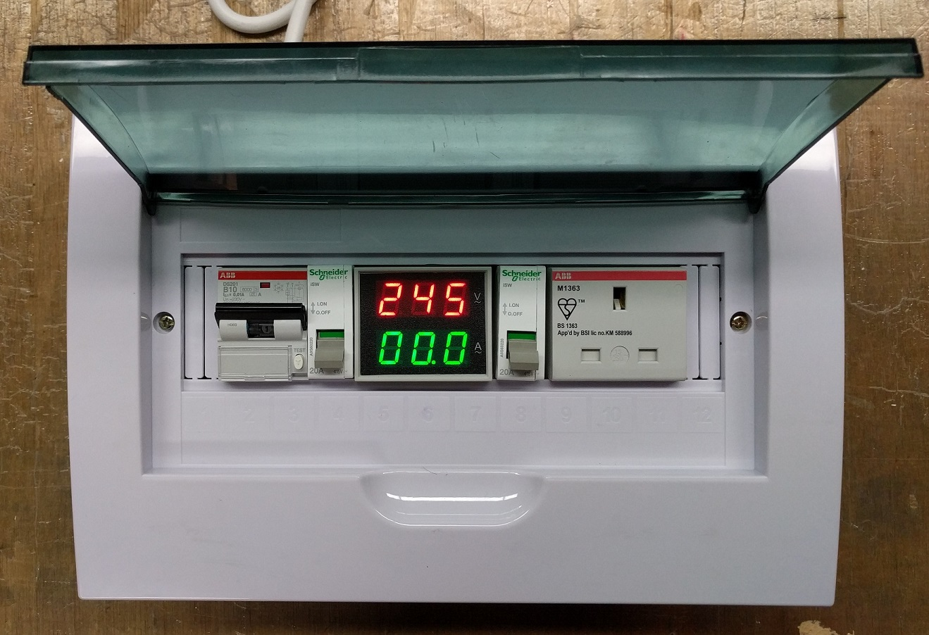
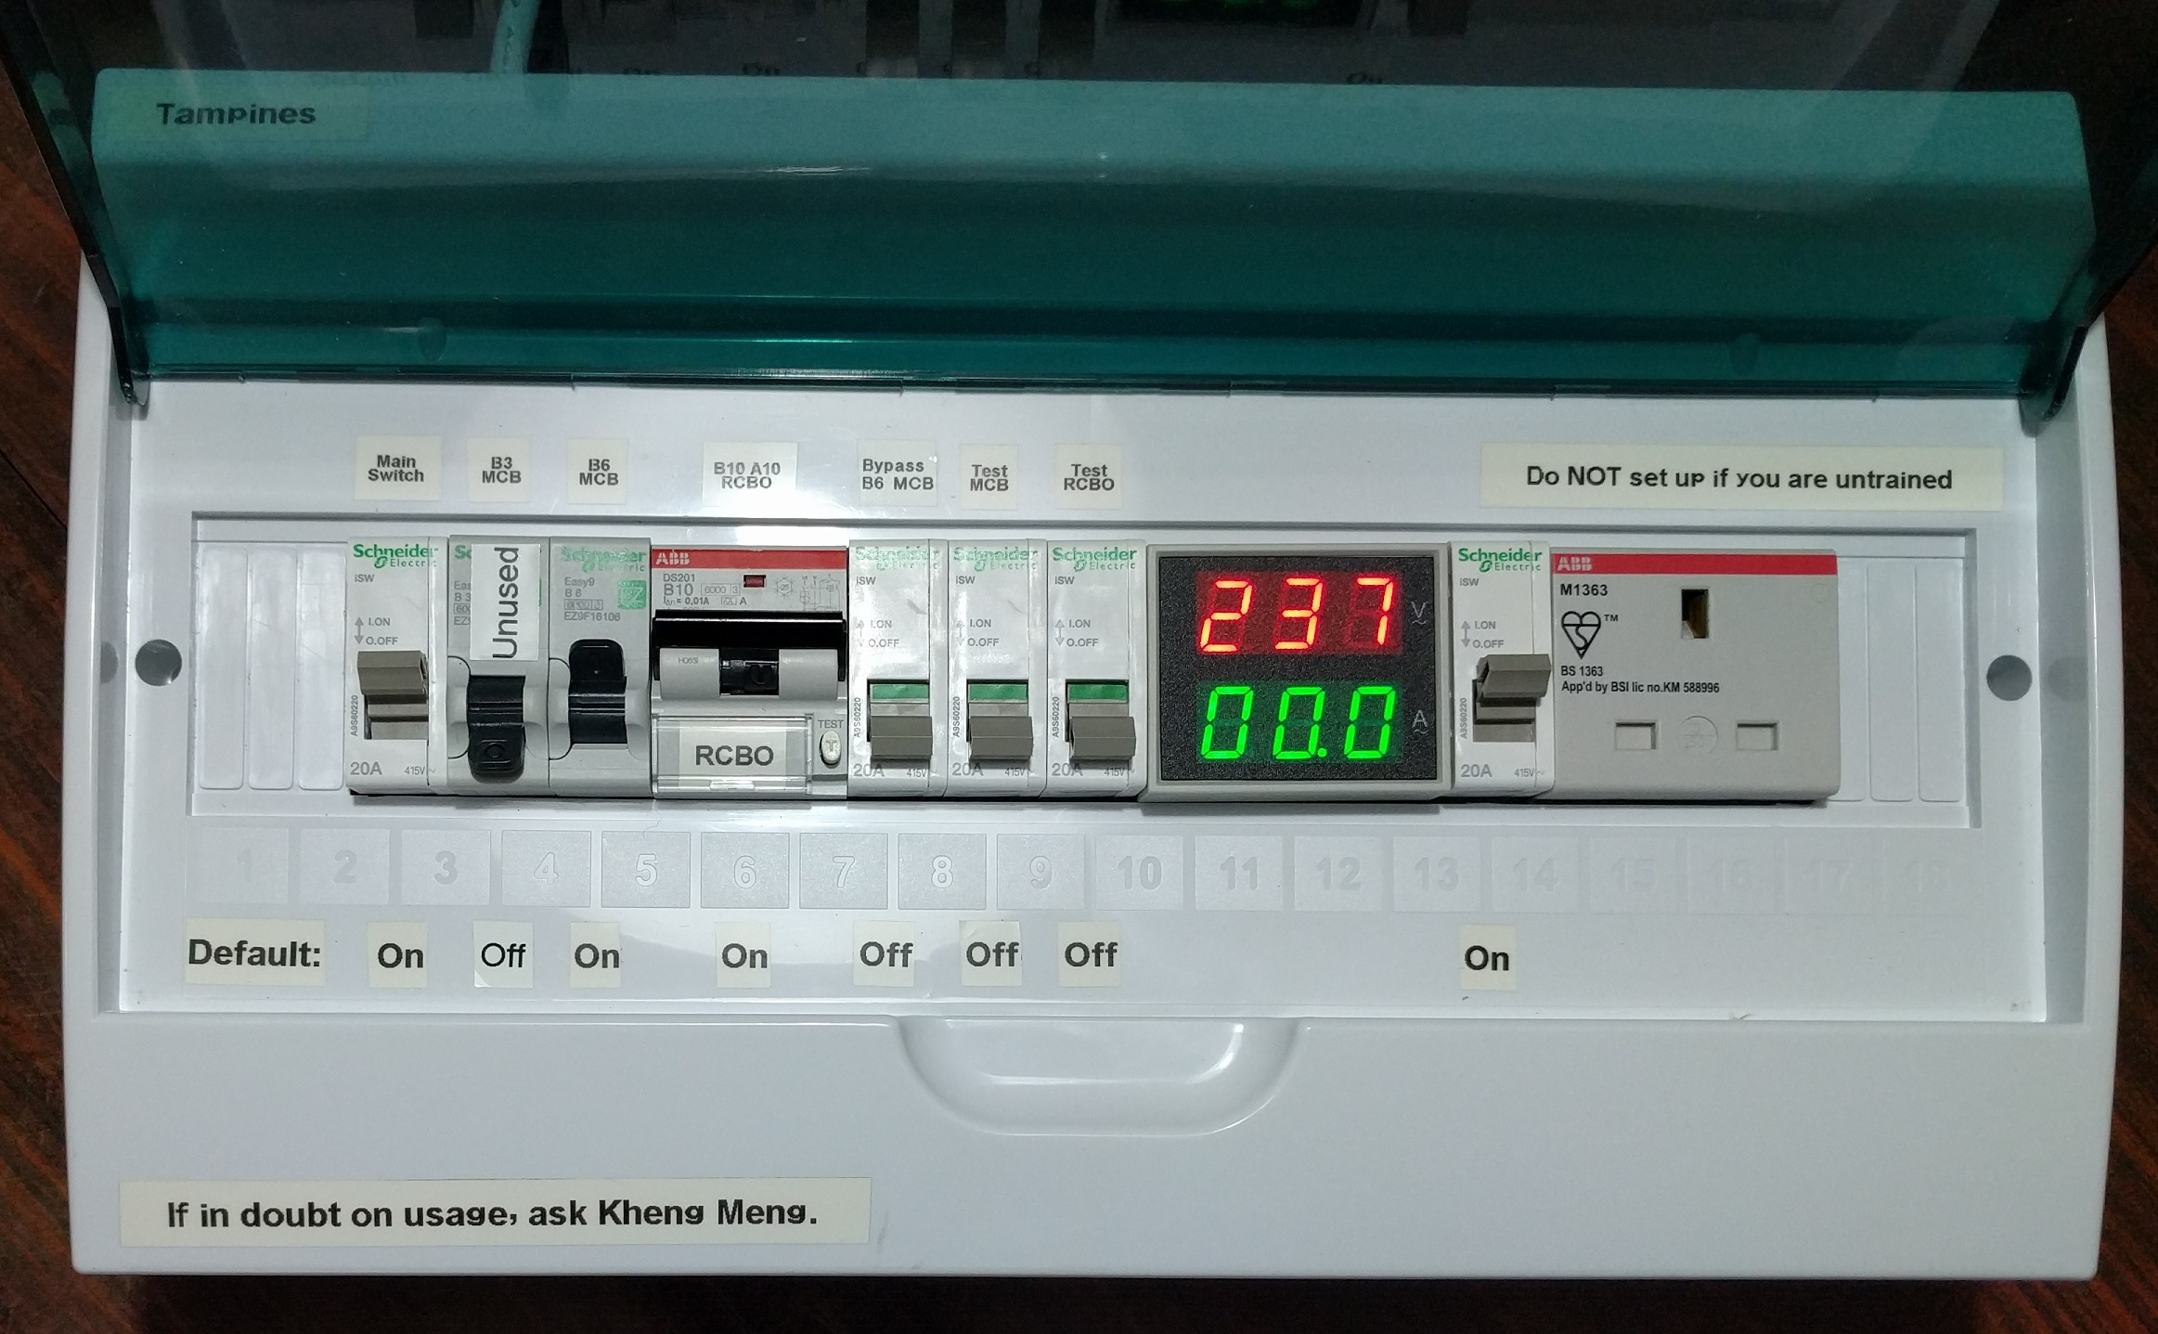
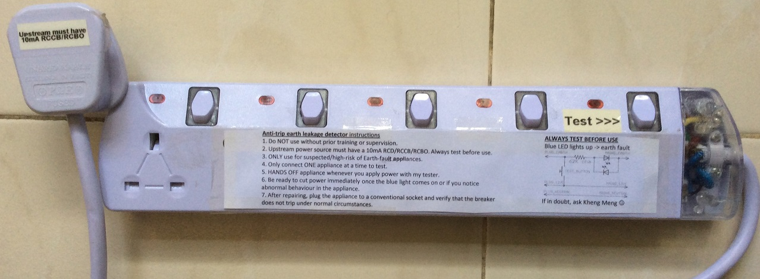
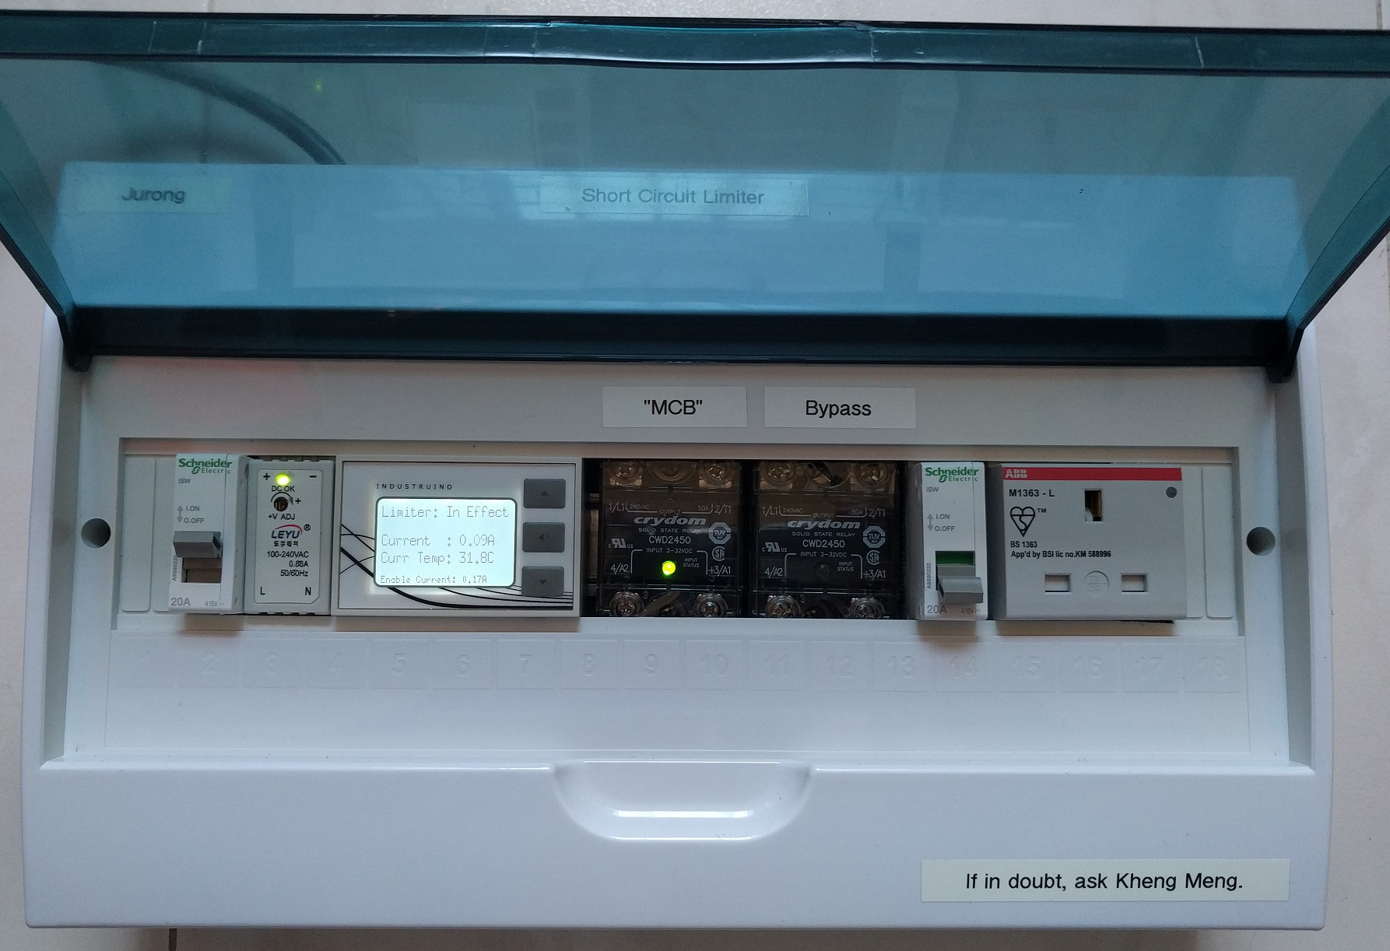
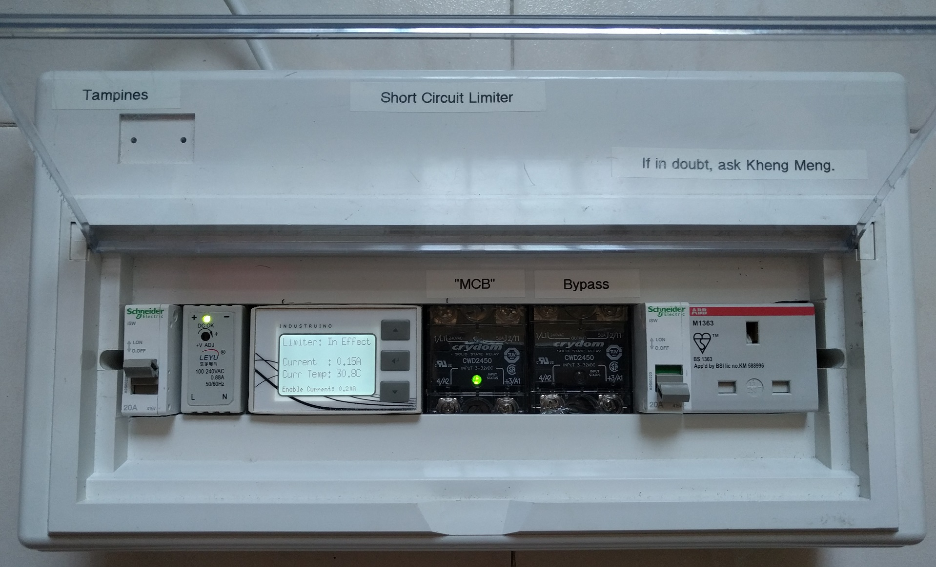
Repair Kopitiam Circuit Breaker Training
By: Yeo Kheng Meng (yeokm1@gmail.com)
https://github.com/yeokm1/repair-kopitiam-training-and-equipment
http://yeokhengmeng.com/2016/05/repair-kopitiam-speciality-electrical-tools/
http://yeokhengmeng.com/2017/07/repair-kopitiam-specialty-electrical-tools-part-2-short-circuit-limiter/
For Repair Kopitiam Training

Slide 2

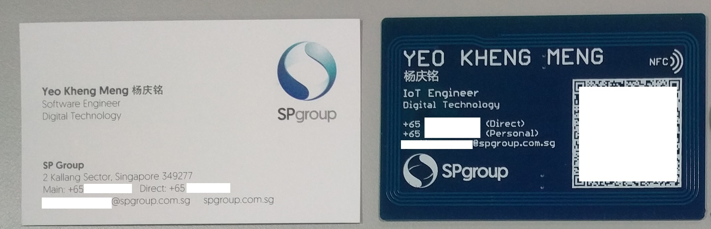
About myself
Volunteered in RK since Mar 2015
2015 NUS Computer Science
IoT Engineer
Singapore Power Digital Technology (since Sept 2016)
RK #2: 8 Mar 2015 @ Blk 425 Jurong West

Slide 3
Agenda
Knowledge Recap
Problems
Solution

Slide 4
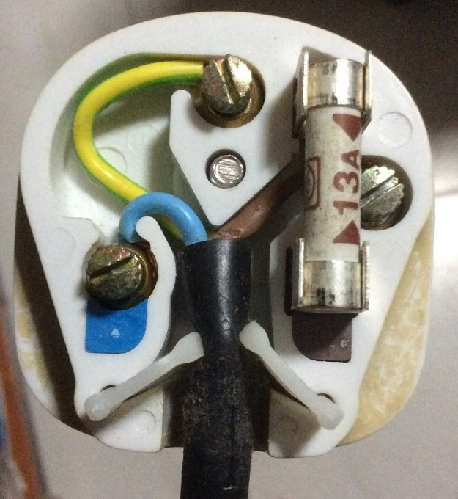
Inside the 3-pin mains plug (BS1363)
Earth
Yellow/Green
Connects to appliance’s external case, protects user from electric shock
Fuse
Blows on overcurrent
Usually 13A
Live
Brown/Red
Source of power
Neutral
Blue/Black
Completes the circuit to generator
Tied to ground at power distribution box to ensure stable 0V

Slide 5
Earth connections: Normal operation
Kettle
Mains Live
Fuse
230V
AC ~
Mains Neutral
Mains Earth
Earth

Slide 6
Live wire touches case
X
Kettle
Mains Live
Fuse
230V
AC ~
Mains Neutral
Mains Earth
Earth

Slide 7
What if there is no Earth wire?
Kettle
Mains Live
Fuse
230V
AC ~
Mains Neutral
Earth

Slide 8
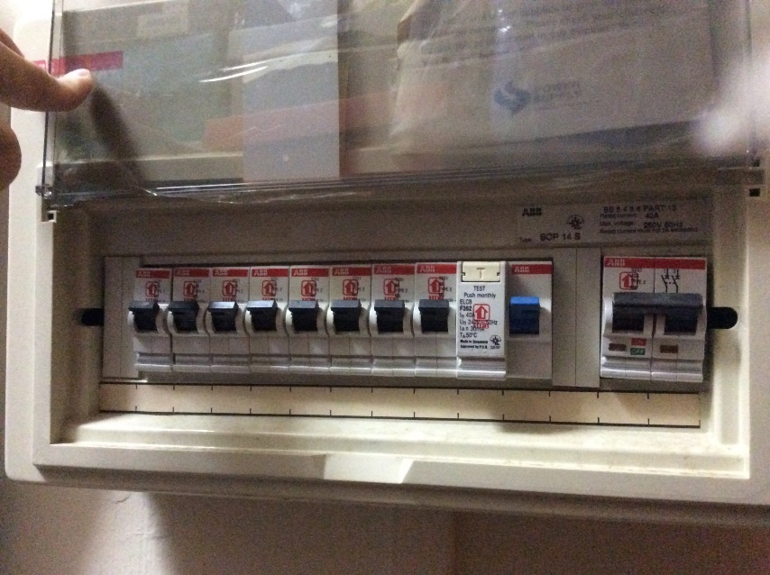
MCB + RCCB Circuit Breakers
MCB
RCCB
Residual Current Circuit Breaker (RCCB)
What it does? Breaks the circuit on earth fault
Cause: Current leakage to Earth
When?: Breaks when current difference between
(|live| - |neutral|)> 30mA threshold
Miniature Circuit Breakers (MCBs)
Breaks the circuit on overcurrent eg. short circuit

Slide 9
Circuit breaker arrangement
Mains Live
Kettle
MCB
RCCB
Fuse
230V
AC ~
Mains Neutral
Mains Earth
Earth
Residual Current Circuit Breaker (RCCB)
What it does? Breaks the circuit on earth fault
Cause: Current leakage to Earth
When?: Breaks when current difference between
|live – neutral|> 30mA threshold
Miniature Circuit Breakers (MCBs)
Breaks the circuit on overcurrent eg. short circuit

Slide 10
Residual Current Circuit Breaker with Overload Protection (RCBO)
Mains Live
Kettle
RCBO
Fuse
230V
AC ~
Mains Neutral
Mains Earth
Earth
RCBO = RCCB + MCB

Slide 11
Blackout recovery procedure
Why? Overcurrent or earth-leakage detected
Turn off every electrical device
Flip breaker to ON
Turn on ONE device at a time. If it trips again, you have found your spoilt device.
Prioritise simple devices like lamps/ovens.
Computers and refrigerators are sensitive to repeated power cycles.
Unplug that spoilt appliance
Flip breaker back on.

Slide 12
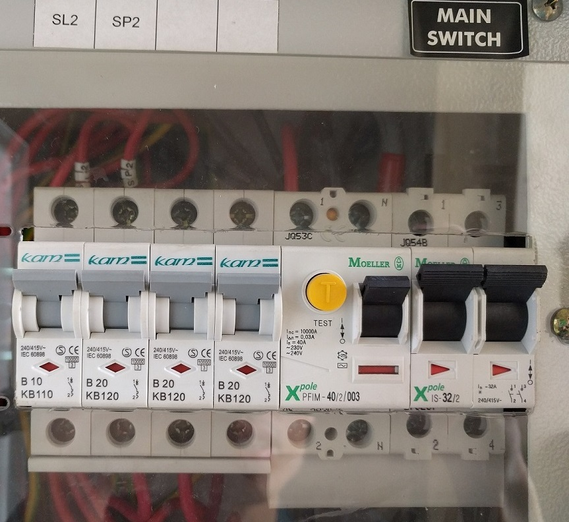
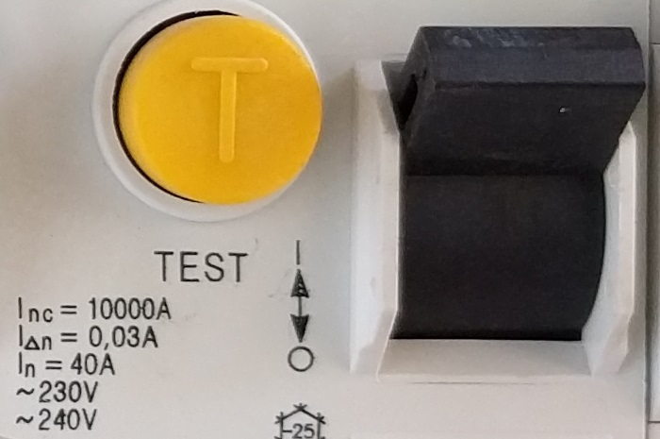
Problem 1: Safety
Typical I_{△n} = 30ma threshold for earth leakage which is still dangerous
Balance between safety and nuisance trips
But RK always deals with high-risk faulty appliances…

Slide 13
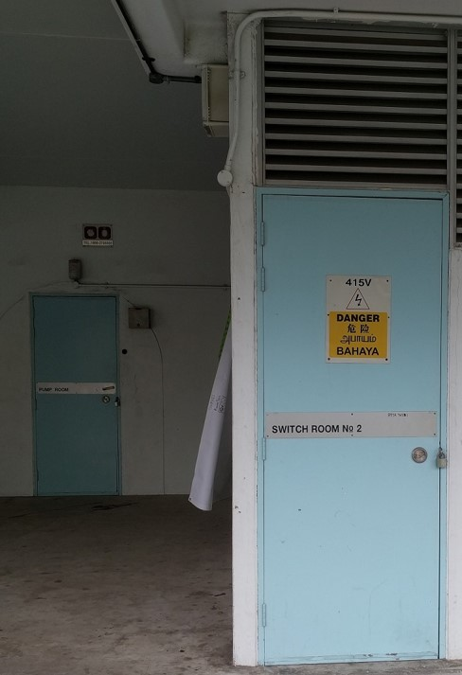
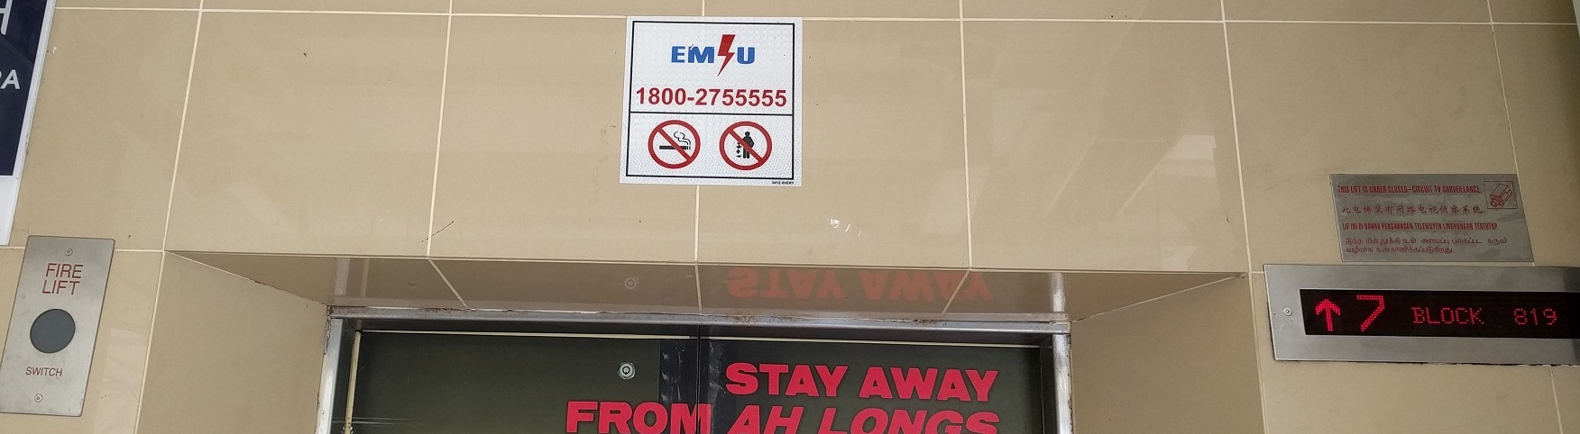
Problem 2: Inaccessible onsite breaker
Circuit breaker inside locked electrical room
Call Essential Maintenance Service Unit (EMSU) to unlock
30-60 mins response time

Slide 14
Problem 3: Inconvenience of breaker trip
Breaker trips affect the work of others eg. Sewing machine

Slide 15
Solution for RCCB earth-leakage trips
Jurong
Tampines
Increased safety due to more sensitive 10mA trip rating
Isolates earth trips to this device, onsite breaker RCCB does not trip
Demo video: https://www.youtube.com/watch?v=h-DokWP5Kic

Slide 16
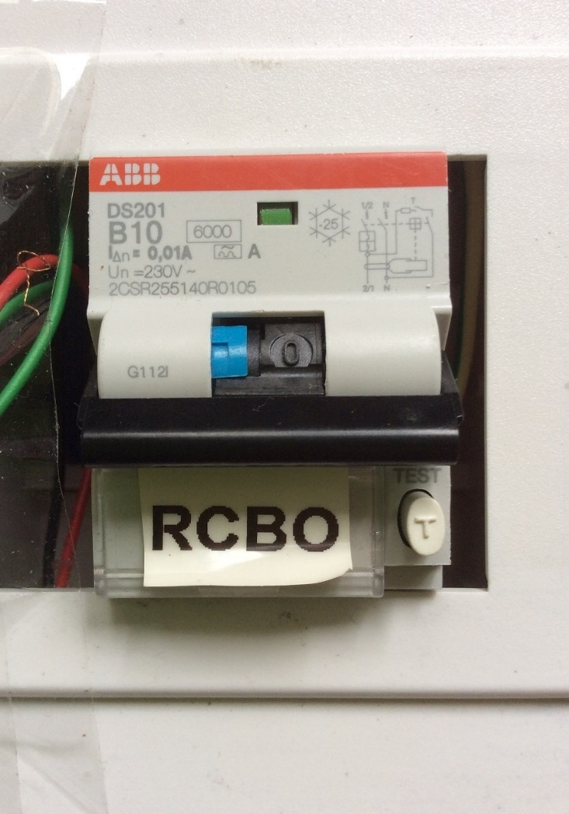
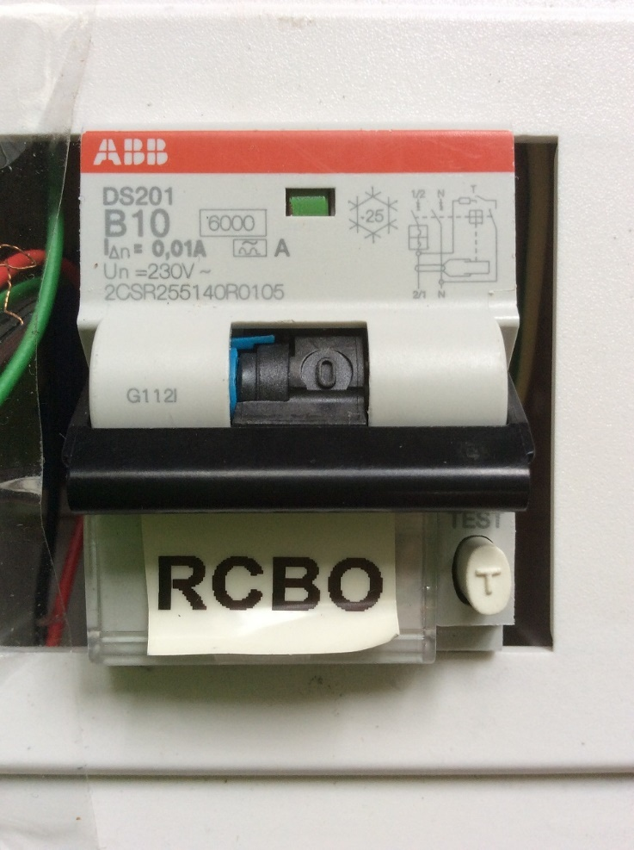
RCBO trip status + Demo
Earth trip: Switch and blue tab is down
Overload trip: Only switch is down

Slide 17
Solution for MCB short-circuit trips
Jurong
Tampines
Isolates short-circuits to this device, onsite breaker MCB should trip lesser

Slide 18
Solution to prevent MCB trip (Demo)
Video URL: https://www.youtube.com/watch?v=VpU6cOnxy0s
20 seconds startup time to let current measurement settle. Notice the left relay is kept off till startup is done.
Turn on a lamp: There is a 1 second delay between turning on the lamp and the second relay being turned on. Also notice the display backlight turns on and the buzzer buzzes once.
Turn off the lamp: The display backlight turns off immediately and the buzzer buzzes twice.
Repeat steps 2 and 3 for the hair dryer. Notice the motor sound is lower during the 1 second period.
Short circuit with a cable with its live and neutral pins shorted. The moment the switch is turned on, the device cuts off power to the outgoing socket. The buzzer also buzzes for a long 2 seconds. Notice the onsite MCB in the room did not trip as the device is still on.
Reset the device with just a simple button press.

Slide 19
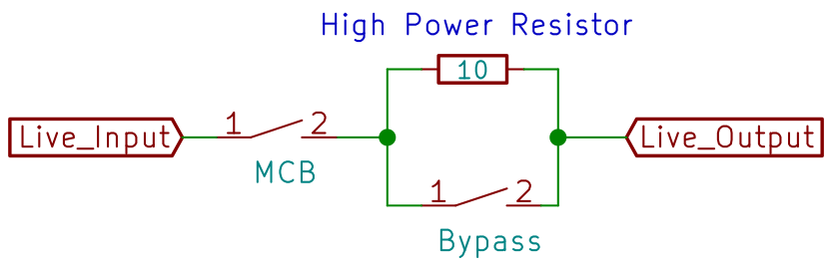
Behaviour State 0
MCB Relay
Bypass Relay
10-ohm resistor

Slide 20
Behaviour State 1
MCB Relay Closed
Bypass Relay Open

Slide 21
Behaviour State 2a
Appliance connected and 1 second of no short circuit
Bypass Relay closes -> Full current
If appliance turns off, go back to State 0

Slide 22
Behaviour State 2b
If short circuit happens, MCB relay opens
MCB relay closes only if user resets the system

Slide 23
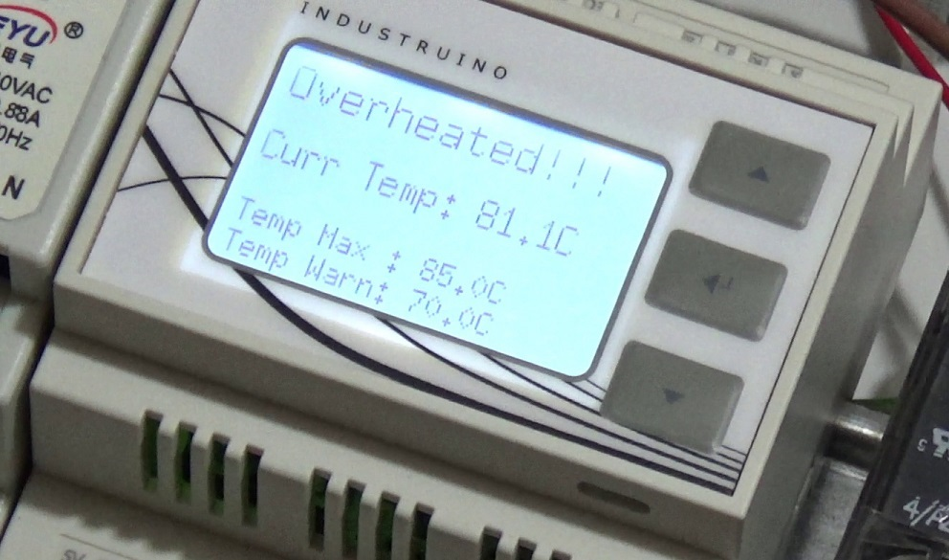
Resistor Overheat Alert
70°C buzzer/blink warning
85°C function ceased till temperature < 70°C
Video URL: https://www.youtube.com/watch?v=O4qB3WehqlA
Should not happen under normal cases

Slide 24
System weakness
Short Circuit after Resistor has been bypassed
Multiple downstream appliances

Slide 25
Test for Earth Leakage without tripping
anti-trip-earth-leakage-detector
Shows blue LED on earth fault without breaker trip
Does not interrupt the work of others
Preserves lifespan of RCBO
Familiarise with usage instructions beforehand
Demo video: https://www.youtube.com/watch?v=tSpie7baYFM

Slide 26
If you want to know more?
About the short circuit limiter
Hackware v3.4
7.30pm, Wed, 6 Sept 2017
Design and Engineering Laboratory, NUS High School
https://www.facebook.com/events/261629434317053/
NOT COMPULSORY!!!

